Slide 1
Research Ethics and RISe
Okanagan Campus Behavioural Research Ethics Board (BREB)
Lisa Shearer Manager, Administration & Compliance Office of Research Services lisa.shearer@ubc.ca; 250-807-8289

Slide 2
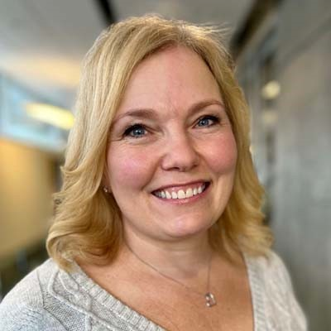
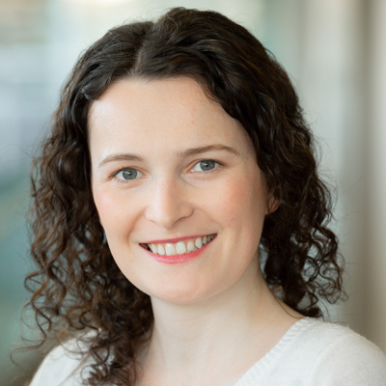
Our Team
Research Ethics support in the Office of Research Services
Lisa Shearer
Rachel Howard
Manager, Administration & Compliance Lisa.Shearer@ubc.ca; 250-807-8832
Research Ethics and Compliance Officer Rachel.Howard@ubc.ca; 250-807-8467

Slide 3
Why Ethics?
Respect for human dignity is the underlying principle
Respect for human dignity requires that all research involving humans be conducted in a manner that is sensitive to the inherent worth of human beings and the respect and consideration that they are due.
UBC Polices LR9 Human Research and LR2 Research govern ethics at UBC along with the Tri-Council Policy Statement (TCPS2)

Slide 4
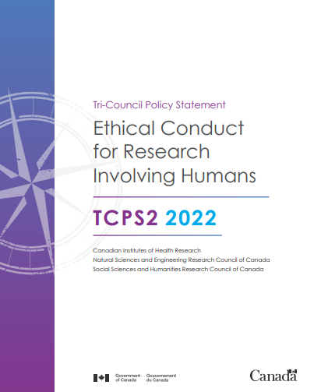
Tri Council Policy Statement (TCPS)
Joint policy of Canada’s three federal research agencies: CIHR, NSERC, and SSHRC
TCPS2: Three Core Principles
Respect for Persons
Respect and consideration; free and informed consent
Concern for Welfare
Protection of welfare, risks and benefits
Justice
Treating people fairly and equitably
Respect for human dignity is underlying principle
Guide: https://ethics.gc.ca/eng/documents/tcps2-2022-en.pdf

Slide 5
TCPS2: CORE-2022 Tutorial
Completing the TCPS2 tutorial is important because it:
Provides basic information
Protects those involved with the research/study
Participants, researchers, the institution
Ensures research is conducted according to ethical requirements
No expiration – so save your certificate!
New version of the tutorial
Consists of nine modules
Tutorial: https://ethics.gc.ca/eng/documents/tcps2-2022-en.pdf

Slide 6
When do you need ethics approval?
Conducting research with human participants
Definitions as per TCPS:
Research – an undertaking intended to extend knowledge through a disciplined inquiry or systematic investigation
Human Participants – those individuals whose data, or responses to interventions, stimuli or questions by the researcher, are relevant to answering the research question

Slide 7
When is ethics approval not needed?
Research that relies exclusively on public information
The intent is NOT research, it is an evaluation, QA/QI etc.
Secondary use of anonymous information
Naturalistic observation of people in public places
The individuals are not the focus of research, but are engaged with only to obtain information
If you are unsure, please ask. Do not assume that ethics is not required.

Slide 8
Behavioural Research Ethics Board (BREB)
Includes: Interviews focus groups, surveys, questionnaires, secondary use of data
No clinical or invasive procedures
May include access to participant's medical records (with consent)
Clinical Research Ethics Board (CREB)
Clinical interventions involving the testing of drugs, medical devices, and rehabilitation exercise programs
The analysis of clinical data obtained from medical records
Studies of a clinical nature involving linkage of data from existing databases
May also involve interviews and questionnaires

Slide 9
What to consider when doing your research:
Participants and potential vulnerability
Research topic and associated risks
Recruitment
Consent
Security of data; protection of confidentiality

Slide 10
Ethics Review Categories
Minimal risk
No greater risks than everyday life
No deadlines; reviewed by designated Board members
Full Board review
Higher risk/vulnerability
Meets once a month; deadlines for submission
Matrix to use to classify:
Vulnerability and risk

Slide 11
Participant Vulnerability
Mental/emotional/cognitive capacity; age; wellness/health; institutionalization; socio-economic status; dependency; power relationships
Decreased ability to safeguard their own interests and provide fully informed consent
Participant vulnerability may vary depending on their circumstances and the type of research

Slide 12
Research Risks
Include:
Physical risks
Psychological or emotional risks
Social risks
Consider the type and the magnitude/seriousness

Slide 13
Addressing Ethical Issues
Just because there is a risk associated with a project/method doesn’t mean that it shouldn’t be conducted;
The goal is to MINIMIZE the risks while MAXIMIZING the benefits;
The BREB is looking for:
Acknowledgment of the issue(s)
Description of how the issue is to be addressed/managed
Rational for proposed methods of managing the issue

Slide 14
Recruitment
Can take various forms – introductory email/letter, posters, third party recruitment or snowballing, in person…
Should include:
PI, Co-I and contact
Title of study
Brief description of study
UBC logo
Should not be coercive in nature; initial contact cannot be by phone; provides sufficient information to determine interest

Slide 15
Consent
Requirement of TCPS2
“Evidence of consent shall be contained either in a signed consent form or in documentation by the researcher of another appropriate means of consent”.

Slide 16
Consent
Ethical Aspects:
Voluntarily confirms his or her willingness to participate
Informs participants of all aspects of the study that are relevant to their decision to participate
Consent shall be maintained throughout the research project
Ability to withdraw at any time
Appropriate language level - participants must be able to understand the document
TEMPLATE AND CHECKLIST AVAILABLE

Slide 17
Confidentiality/Security of Data
Researchers have an ethical duty of confidentiality – obligation to safeguard information entrusted to them by protecting data from unauthorized access, use, disclosure, modification, loss or theft
How will confidentiality and participant privacy be maintained during and after the study?
Standard measures: password protection, encryption, storage in locked filing cabinet
Security is necessary, but not necessarily easy. However, it is easier to protect than to explain a breach or loss of data

Slide 18
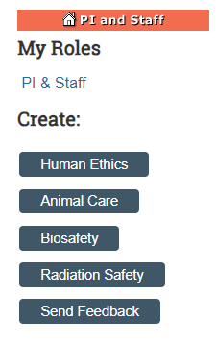
I need ethics – where do I start?
CWL access is required
Register for RISe access: www.rise.ubc.ca
Complete the TCPS2 tutorial
To start an application, clink on Create: …Human Ethics
List your supervisor as the Principal Investigator (PI) in Section 1.1, and yourself as the Co-Investigator (Co-I) in Section 1.3 and as the primary contact in Section 1.2

Slide 19
The Research Ethics Board Review Process
The PI (your supervisor) MUST review and submit the application
REB Review Stage: the application will be assigned to a board member for review, will be reviewed by the full board, or returned to you for extensive changes
Please plan ahead and allow 5-7 weeks from when the application is submitted for approval
Once your study is approved, any changes you make to the study must be reviewed and approved through an amendment PRIOR to implementing

Slide 20
Need Assistance?
UBC Okanagan: https://ors.ok.ubc.ca/ethics-compliance/research-ethics/
submission dates for full board
guidance notes
UBC Ethics: https://ethics.research.ubc.ca/behavioural-research-ethics
guidance notes
sample applications
consent form templates
consent form checklist, application checklist

Slide 21
Research Ethics Matter. Big Time. Got REB? Need REB? Just ask. breb.ok.ubc.ca

